Slide 1
Panduan Penggunaan
Terima kasih telah download template curriculum vitae (CV) atau resume dari www.Finansialku.com
Jika Anda mengalami kesulitan pada saat pengisian, silakan cek website :
https://www.finansialku.com/free-download-curriculum-vitae-cv-atau-resume/
https://www.finansialku.com/free-download-surat-lamaran-kerja-atau-cover-letter/
Pada slide 5, Anda dapat melihat contoh CV yang sudah jadi (dalam bahasa Inggris).
Anda dapat mengisi CV Anda pada slide 6 (dalam bahasa Inggris) dan/atau slide 7 (dalam bahasa Indonesia).
Jika Anda sudah mengisi CV, simpan dalam bentuk PDF, caranya lihat pada panduan slide 1 sampai dengan slide 3.
Jangan lupa bagikan ke teman-teman Anda.

Slide 2
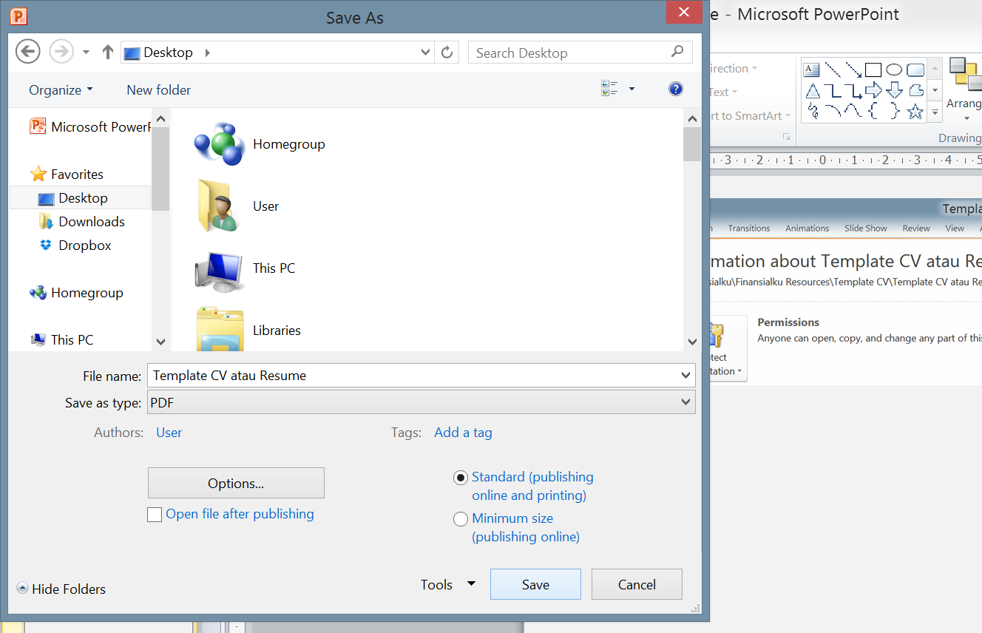
1
2
Klik File
Klik Save As
3
4
Save as type pilih PDF
Klik save
www.Finansialku.com FBB Finansialku FBB Finansialku_com

Slide 3
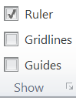
Permasalahan
Jika Anda menemukan tampilan seperti ini:
terdapat garis-garis (disebut grid)
Cara menghilangkannya:
1
2
Klik view
Un Check Gridlines dan Guides
Silakan kirim pertanyaan dan saran
E. : Solusi@Finansialku.com
P. : 022 – 2056 5890
M : 0819-1151-6119
www.Finansialku.com FBB Finansialku FBB Finansialku_com

Slide 5
CONTOH / EXAMPLE
JOHN DOE S.I.Kom., MBA.,
marketing communication
0812 3456 7890
Email@JohnDoe.com
JohnDoe
Jl. ABC 123 Jakarta
JohnDoe
JohnDoe.com
ESFJ
01/01/1985
Married
Marketing Supervisor
2012 / now
Indonesia
PT. Retail ABCDEF
Indonesia, English
Managing the area communication team. Preparing monthly detailed progress report on effectiveness for sales director.
Senior Communication Officer
2010 / 2012
PT. Retail ABCDEF
Managing the regional I communication team. Preparing monthly detailed progress report on effectiveness for manager.
I am looking for marketing manager which offers me the opportunity to develop new skills while strengthening those I already possess.
My experiences had enabled me to develop good organizational skills, an analytical/logical approach to tasks and the ability to work under pressure. I am able to work well both on my own initiative and as part of a team.
My main strengths are adaptability, and the determination to get a job done. I try to learn something new from every experience because I believe there is always room for self-improvement both personally and professionally.
Communication Officer
2007 / 2010
PT. Retail ABCDEF
Working with a team to plan and implement media campaigns. Preparing first drafts of press release.
Intern Communication Officer
2006 / 2007
PT. Retail ABCDEF
Helped communication staff to prepare the media campaigns.
Master of Business Administration
2011/2013
Universitas ABCDEFG
focusing on marketing management and digital marketing for business. GPA : 3,7 / 4,0
Persuasive Communication
Networking
Communication
2003 / 2007
Creative and Hardworking
Universitas ABCDEFG
Email Marketing, Ms. Office
focusing for mass communication and retail.
GPA : 3,4 / 4,0
Notes:
Sumber gambar:
Man Suited – Freepik.com –
http://www.freepik.com/free-photo/skyscraper-view-city-leader-window-frame_1074640.htm#term=man suit&page=1&position=12

Slide 6
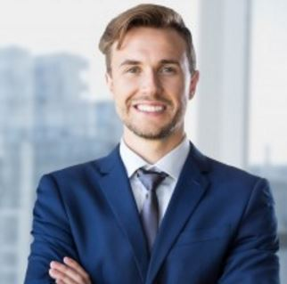
CONTOH / EXAMPLE
JOHN DOE S.I.Kom., MBA.,
marketing communication
0812 3456 7890
Email@JohnDoe.com
JohnDoe
Jl. ABC 123 Jakarta
Jakarta, 10 May 2017
Dear Mr. Ryan
PT. ABCDEFG HRD, Jakarta
After contributing to the growth and success three different organizations in the past 5 years, I am seeking new challenges with a company in need of someone with exceptional planning, leadership, and management abilities.
Taking command of an communication and marketing skills, then guiding it to new performance levels, is my greatest strength.
As evidenced in the enclosed resume my experience encompasses project management, strategic planning, resource utilization, revenue growth, and cost reduction. My ability to analyze needs and create unique solutions designed to yield a profitable outcome has proven to be one of my greatest assets.
Credited with significantly impacting bottom-line profitability wherever I have worked, I excel at streamlining less-than-efficient procedures to boost productivity and sales. Proactive management of crucial external relationships allowed me to increase revenue by 17% in one year. I also negotiated exclusive relationships in a key market segment, expanding the company's share of that segment by 66%.
I know that my proven leadership skills, strong commitment to high ethical and professional standards, and flexibility in devising proactive responses to changing socioeconomic conditions would allow me to make a significant contribution to the PT. ABCDEFG team. I would welcome the chance to discuss my qualifications with you in greater detail. I know that you are busy, and have many applications to review. If you wish to schedule a meeting, please let me know. In the meantime, please know that I appreciate your time and consideration.
Regards,
John Doe

Slide 7
Bahasa Inggris

Slide 8
Bahasa Indonesia

Slide 9
Bahasa Indonesia / Bahasa Inggris

